Slide 1
Jupiter Mutual Events
Sep 2014 to Aug 2015

Slide 2
A mutual event is an eclipse or occultation of one satellite by another satellite
Mutual events can only occur when the plane of the orbits is edge-on to the Earth. For Jupiter, this occurs for a 12-month period every 6 years.
Measuring/analysing the light curve leads to very precise measurements of the relative positions of the satellites. These can be used to improve our knowledge of the orbits, and long-term orbital variations

Slide 3
Example occultations
Ganymede Occults Europa – 2015 Jan 4
Io occults Ganymede – 2015 Jan 1

Slide 4
Example eclipses
Europa eclipses Ganymede – 2015 Jan 1
Ganymede eclipses Europa – 2015 Mar 2
Callisto eclipses Io – 2015 Jan 7

Slide 5
Results from previous seasons
For the 2009 season:
370 events were ‘observable’
172 different events were observed, at 74 sites
457 light curves obtained and reduced

Slide 6
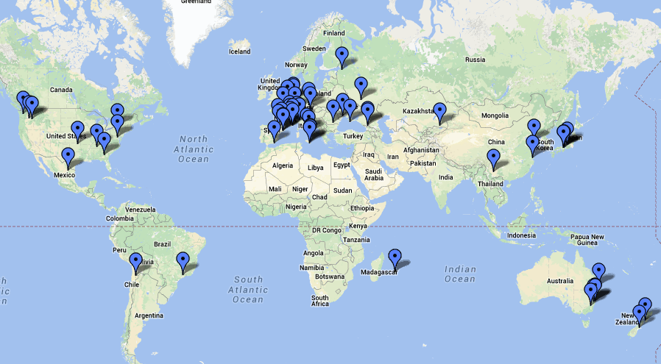
2009 - Observer locations

Slide 7
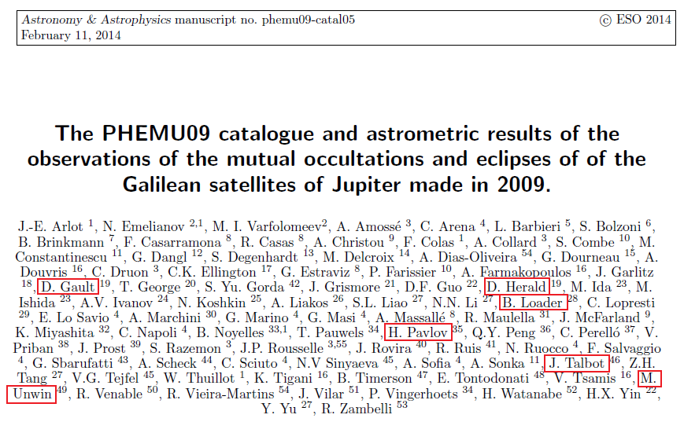
All observers get to be a joint author of a paper

Slide 8
What does a mutual event ‘look like’
Break for a video

Slide 9
Observing requirements
Driven Telescope (but need not be equatorial)
Time to 0.1 secs UTC – GPS, NTP**, WWVH
Video with time stamp
Can achieve this by recording to a VCR, with VCR time stamp recording enabled. But need to check correction to VCR clock at start and end.
Recorder – VCR, Computer
Frame grabber – to convert to a .avi file

Slide 10
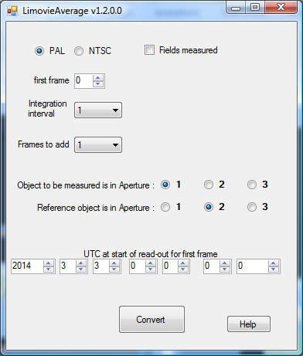
Measuring tools
Limovie, or Tangra
LiMovie Average (or its successor) to improve measurements by binning and normalising

Slide 11
Reporting
Observations reported to IMCCE
{effectively, Paris Observatory}
Simple text report (standard form) with attached .csv and optional plot

Slide 12
Observing issues
Need to compress the video when creating the avi file – otherwise the file will be HUGE
Concerns about linearity of the video camera. Where possible, make sure the Gamma is set to 1.
Image motion – minimise. In particular, any vignetting across the field will cause light variations if there is significant image movement

Slide 13
Observing issues 2
IMCCE recommend the use of a red filter – reduce sky background
For events close to Jupiter’s limb – experiment with a Methane filter (if you happen to have one – they are expensive!). But exposures will have to be much longer
Highly desirable to have several independent observations of the same event
Best to avoid saturated images of the satellites – but no concern if the saturation is not great.

Slide 14
Observing issues 3
Closeness to Jupiter can create problems with correcting for sky background, which will have a 2nd-order variation with distance from Jupiter. Aperture sizes and shapes can affect the measurement result.
Tangra may be improved to model the glare from Jupiter, to improve background subtraction

Slide 15
Example light curves (from IMCCE)
Good Bad

Slide 16
Example light curves (from IMCCE)
Good Bad

Slide 17
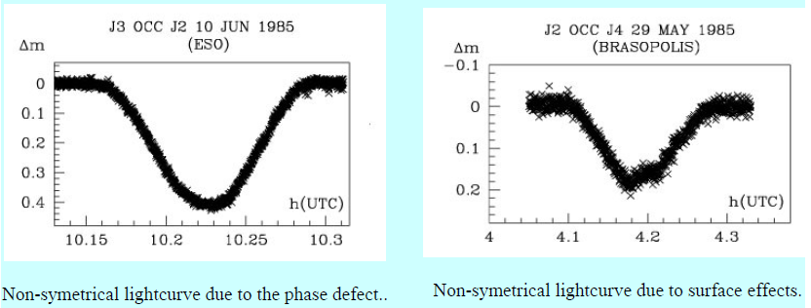
Example light curves (from IMCCE)
Non-symmetrical light curves, due to:
Phase defect Surface effects

Slide 18
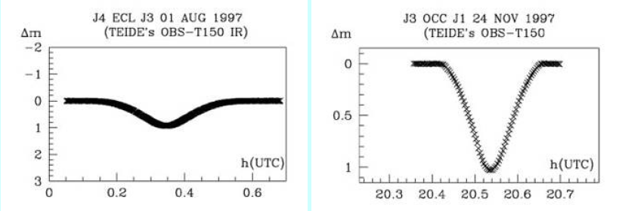
Example light curves (from IMCCE)
The beginning and end of an eclipse is smoother than for an occultation
Eclipse Occultation

Slide 19
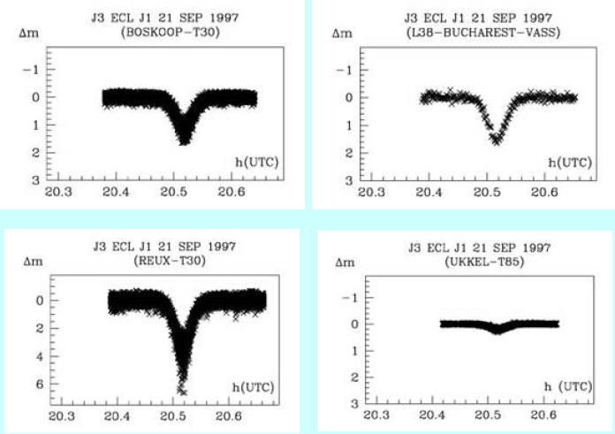
Example light curves (from IMCCE)
Need to be careful with calibrating the light level
4 light curves of the same event...!!

Slide 20
Example light curves (from IMCCE)
Need to be careful about time – if not using GPS video insertion
Two light curves of the same event – but different time!

Slide 21
More info & guidance
IMCCE has a dedicated web page at:
http://www.imcce.fr/phemu/

Slide 22
Summary of events visible from Eastern Australia/New Zealand
2014 | # events | 2015 | # events
Sep | 1 (1 ecl) | Jan | 25 (13 ecl, 12 occ)
Oct | 1 (1 ecl) | Feb | 23 (13 ecl, 10 occ)
Nov | 7 (7 occ) | Mar | 25 (15 ecl, 10 occ)
Dec | 5 (1 ecl, 4 occ) | Apr | 13 (4 ecl, 9 occ)
 |  | May | 12 (4 ecl, 8 occ)
 |  | Jun | 9 (1 ecl, 6 occ)
 |  | Jul | 3 (1 ecl, 2 occ)
 |  | Aug | 1 (1 occ)
Jupiter at opposition
2015 Feb 6
One event {2014 Dec 21 - (III) occ (1)} occurs during transit of Jupiter’s disc, ending just minutes before the transit finishes

Slide 23
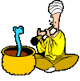
Questions?

